Slide 1
Chapter 18

Slide 2
Objectives

Slide 3
Objectives (continued)

Slide 4
An example that illustrates a closure

Slide 5
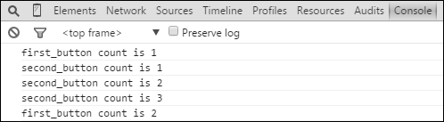
The Console panel after clicking the two buttons several times

Slide 6
A function that creates a closure with private state

Slide 7
Code that creates and uses the slideshow object returned by the function

Slide 8
How to use the bind() method to set the value of an inner function’s this keyword

Slide 9
How to use a variable to store the value of an outer function’s this keyword

Slide 10
Terms

Slide 11

The Slide Show application in the browser

Slide 12
The HTML for the Slide Show application

Slide 13
The library_slideshow.js file for the Slide Show application

Slide 14
The library_slideshow.js file (continued)

Slide 15
The library_slideshow.js file (continued)

Slide 16
The main JavaScript file for the Slide Show app

Slide 17

The slideshow object in the Watch Expressions pane

Slide 18
A function expression that is defined and then invoked

Slide 19
Two ways to code the parentheses of an IIFE

Slide 20
Some benefits of using an IIFE

Slide 21
An IIFE that keeps a variable from conflicting with another variable of the same name

Slide 22
What else you need to know about closures

Slide 23
How this affects closures in a loop

Slide 24
How to fix the loop problem by calling a function that returns a function

Slide 25
How to fix the loop problem by using an IIFE

Slide 26
The pros and cons of object literals vs closures

Slide 27
A module pattern that creates a single slideshow object with private state

Slide 28
How to create a namespace

Slide 29
An example that uses an IIFE to augment the slideshow object

Slide 30
An example that uses the slideshow object’s new method

Slide 31
How to use an accessor property to provide limited access to a private variable

Slide 32
Terms

Slide 33
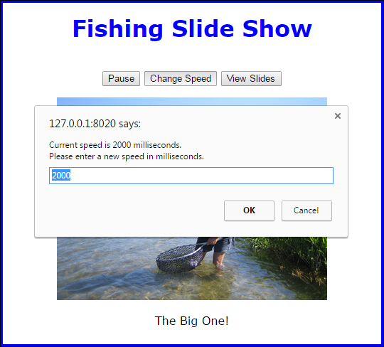
The Slide Show app with the module pattern after the Change Speed button is clicked

Slide 34
The HTML for the Slide Show application

Slide 35
The library_slideshow.js file for the Slide Show application

Slide 36
The library_slideshow.js file (continued)

Slide 37
The library_slideshow_enhancements.js file for the Slide Show application

Slide 38
The main JavaScript file for the Slide Show app

Slide 39
The module pattern of a jQuery plugin

Slide 40
The module pattern of a jQuery plugin (cont.)

Slide 41
Naming conventions for plugin files

Slide 42
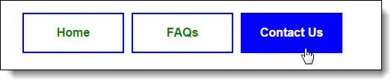
A menu that is highlighted by the highlightMenu plugin

Slide 43
The HTML for the menu

Slide 44
The CSS for the menu

Slide 45
The highlightMenu plugin in a file named jquery.highlightmenu.js

Slide 46
The highlightMenu plugin with options

Slide 47
The highlightMenu plugin with options (cont.)

Slide 48
jQuery that uses the highlightMenu plugin and sets one of its options

Slide 49
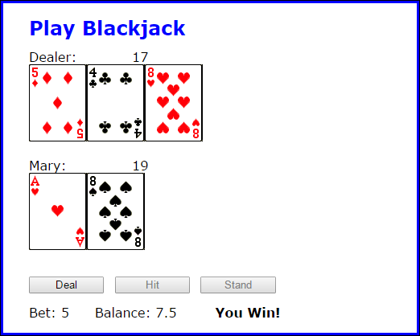
A Blackjack application that uses a blackjack plugin

Slide 50
The HTML for the Blackjack application

Slide 51
The main JavaScript file for the Blackjack app

Slide 52
The jquery.blackjack.deck.js file for the blackjack plugin

Slide 53
The jquery.blackjack.deck.js file (continued)

Slide 54
The jquery.blackjack.hand.js file for the blackjack plugin

Slide 55
The jquery.blackjack.hand.js file (continued)

Slide 56
The jquery.blackjack.game.js file for the blackjack plugin

Slide 57
The jquery.blackjack.game.js file (continued)

Slide 58
The jquery.blackjack.js file for the blackjack plugin

Slide 59
The jquery.blackjack.js file (continued)

Slide 60
The jquery.blackjack.js file (continued)

Slide 61
Some popular JavaScript minification tools

Slide 62
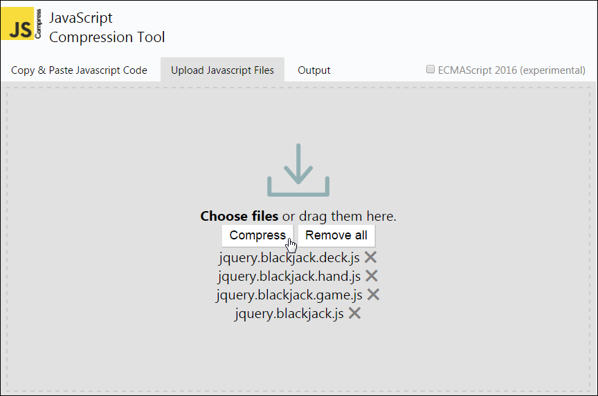
The jscompress.com website with the four plugin files uploaded

Slide 63
Some of the JavaScript code in the resulting jquery.blackjack.min.js file

Slide 64
Extra 18-1 Convert the Clock app to closures

Slide 65
Extra 18-2 Use namespaces and the module pattern with the Clock app

Slide 66
Extra 18-3 Enhance the Clock app’s stopwatch

Slide 67
Extra 18-4 Create a rollover plugin

Slide 68
Short 18-1 Fix the closure loop problem

Slide 69
Short 18-2 Modify the Slide Show app

Slide 70
Short 18-3 Create a FAQs plugin

